Slide 1

Machine Learning J Component Review 1
Taxi fare prediction using Machine Learning
Raghav K
20BCE1468
Keerthana V
20BCE1561

Slide 2
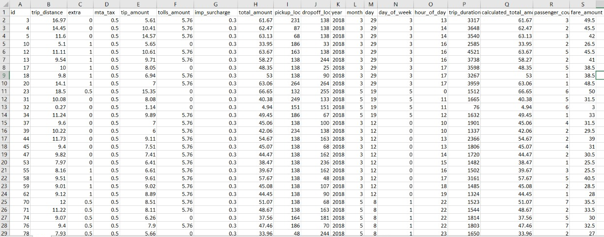
Scope or Aim of the project
We aim to analyze the fare or price of taxi aggregator using various factors or feature parameters namely trip distance, waiting charges during or before the trip, tax like toll amount and other charges like GST (CGST, SGST), location, passenger count etc
As dataset has over 1048575 rows and 19 columns having a huge collection of data, it might sound too hard to predict the fare of the taxi
But what if we can turn it from a bane to boon, making it advantageous for us? How is this possible might be your question, isn’t it?
You will have learnt the answers to the above questions by yourself in the upcoming slides

Slide 3
Each of the above properties have a role to play in our project and it helps in determining if the user(s) are willing to use our application (service) over other cab aggregators
We need to analyse over 1,99,22,925 data or values (1048575 rows * 19 columns)
Thus, the aim of our project is delivered the least or lowest possible fare or cost to the customer with viable options to choose and the drivers being content at the same time. We used the “taxi ride” dataset which can be accessed using the link:
We also wish to bring to your notice that we have started the implementation part, starting with the pre-processing of data

Slide 4

Thus, will almost complete the implementation of the project by 2nd review where we will show the algorithm of Regression, Decision Tree, Random Forest, Gradient Boosting Machine (GBM) that yields an accuracy of 95%
We also plan to implement another model that we have done in the class to compare which gives a higher accuracy and how their behaviour vary due to the accuracy of the model

Slide 5

Main features of our project
We have used the various Exploratory Data Analysis (EDA) methods, visualized the fata using violinplot, pairplot, subplot, histogram, check for the different statistics of the dataset like the passenger count is greater than 6 or fare amount cannot be negative, analyze outliers using boxplots,
Feature Engineering for timestamp variable, passenger count, use"get_dummies" converts categorical data into dummy or indicator value
Feature Selection where features move together directionally. Linear models assume feature independence. And if features are correlated that could introduce bias into our models
Feature Scaling Check with or without normalization of Standard Scalar
We then use Random Forest, Decision Tree, Lasso Regression for analyzing the dataset to predict the accuracy of the model and we notice that Decision Tree has higher accuracy

Slide 6

Think of a problem where a user books a ride from a source X to destination Y and is being dropped by a unique driver assigned to the customer who is closer (distance vector formula)
This might sound simple as to what might be the difficulty in this problem statement
But soon did we realize that when many users might want to start from the same source and there is a possibility that there might be a clash
Objective

Slide 7
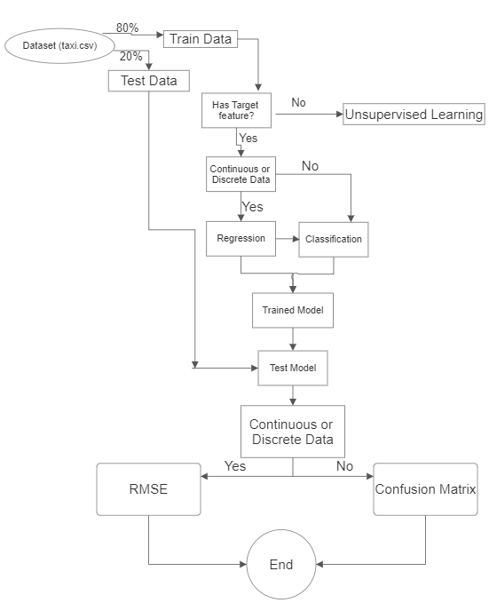
Block Diagram

Slide 8
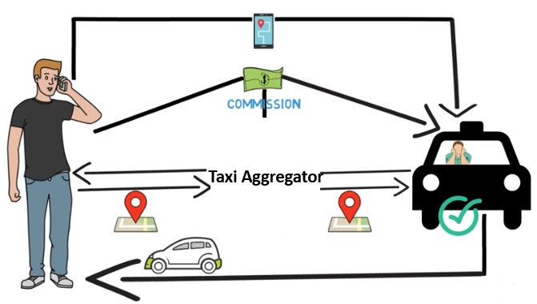
We have analysed that over 120 million+ users, 5 million taxi drivers and almost 17 billion trips or rides made per day, as to why we have we have planned to choose the “taxi ride” dataset consisting of a famous taxi provider of India and abroad
In this dataset, we get information about the pickup and dropoff location ID, taxes levied, trip distance, duration, category of ride namely business or normal, purpose (entertainment, education, work etc)
Also, note the last column (total fare amount) is calculated on the basis of trip distance, various tax amount shown in the dataset, the waiting time also had a major role in deciding the fare of the taxi
Hence, in this we plan to collect the real-time data from the applications (app) to do the data analysis and predict if or not the user is likely to choose our service over others

Slide 9

Also, we perform feature selection thus reducing the number of features from the dataset
This is done to get the optimal results and thus the algorithm of Decision Tree which yields an accuracy of more than 96% for this dataset

Slide 10
Dataset Link
https://www.kaggle.com/code/neilclack/taxi-trip-cleaning-analysis/data

Slide 11

Link for Implementation in Google Colab
https://colab.research.google.com/drive/1V3YTrQKVaYl5hjoRgtauhOntPKqvW0eW#scrollTo=Te4i9dhoXulH

Slide 12
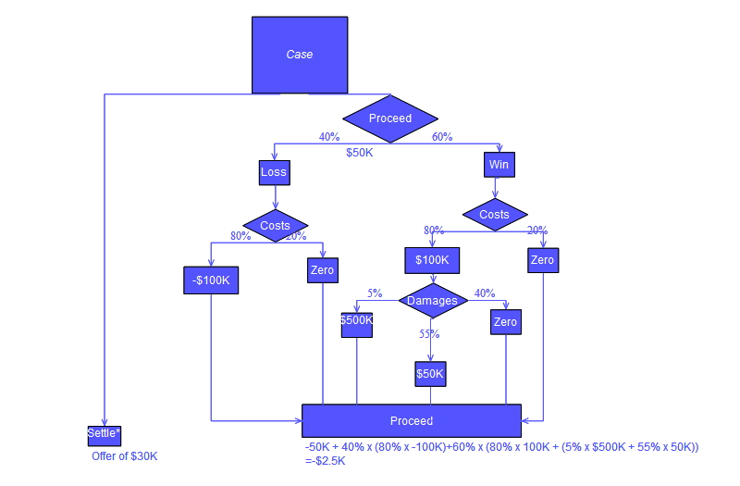
The Random Forest and Decision Tree techniques used will effectively help us to analyze the cut-off fare asked by the taxi aggregators
This allows each driver and passenger to reduce the time it takes to locate one another
Drivers don't have adequate information on where passengers and different cabs should go
As a result, a cab centre will coordinate the taxicab fleet and efficiently provide uniform requests to the entire municipality
Methodology

Slide 13
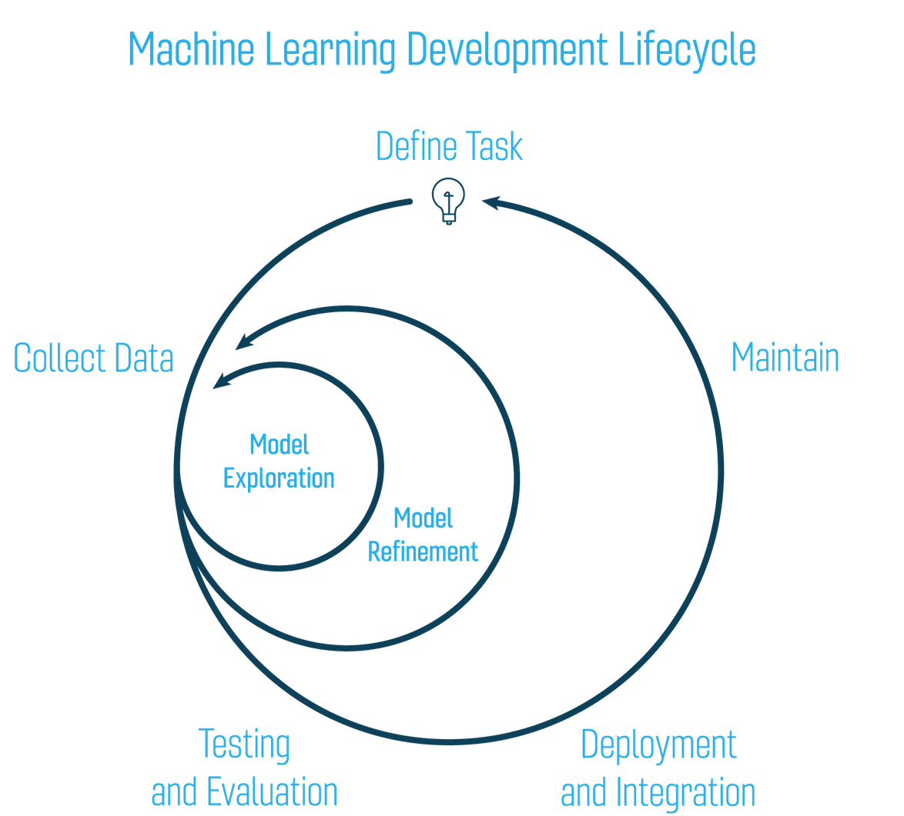
The technique makes use of the scheduled cab's latitude and longitude as well as the day of trip and the month
With this dataset, an unsupervised learning model is developed, and the model is used to predict the pickup of the cab on the cluster
The proposed project method is broken down into seven parts namely
System Architecture
Raw Data (Dataset)
Data Importing
Data Visualization
Testing Data
Predicted Scheduling of cab using algorithm
Algorithm

Slide 14
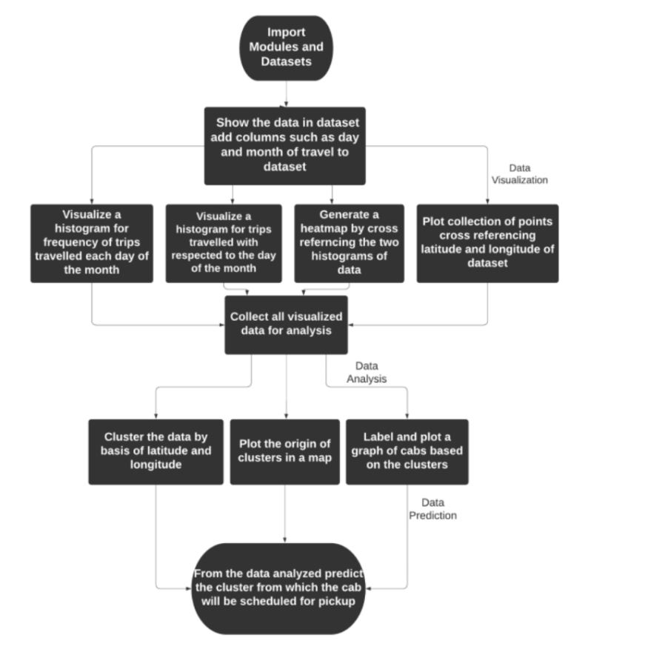
The system architecture for the given module is as
follows
Raw Data (Dataset)
The term "raw data" refers to unprocessed data that is collected from a dataset or is created as a result of data processing
Extraction, organisation, and sometimes analysis are all needed phases in raw data
Data Importing
x_{i} rides will provide a massive quantity of trip data for training and testing purposes

Slide 15
The latitude will be grouped and categorised from the acquired dataset depending on the frequency of journeys taken by the cab during the day
When these requirements are met, data preprocessing will be performed on these datasets
Data Visualization
Data visualization is described as evaluating the performance of a model using graphs and metrics that compute performance
Data visualization is mostly used to categorize data into new levels so that the technique may be applied to an observation of each output variable produced from an observed input variable

Slide 16
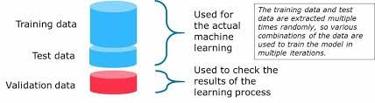
Testing data
After visualizing data in an algorithm, the major step is to test the data
A test set may be described as a set of observations used to evaluate the performance of a model using performance metrics
The programme that utilises the test set must be able to generalise and successfully perform with the dataset in order to reliably provide the expected data, indicating that the programme is effective

Slide 17
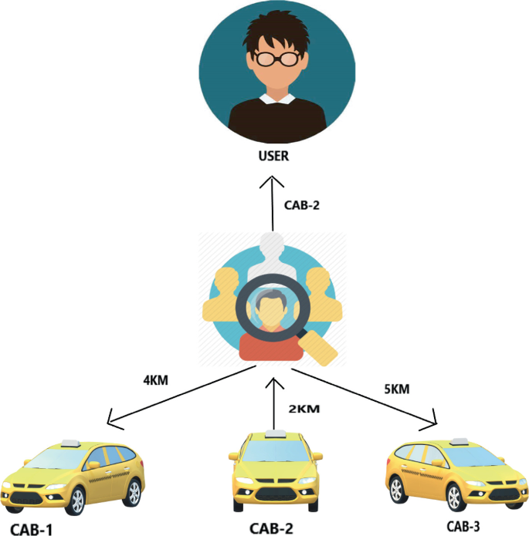
Furthermore, overfitting occurs when the computer memorises the dataset; therefore, to balance overfitting, we utilise regularisation, which is applied to the model to lessen it
Predicted Scheduling of Cab using the algorithm
The cab's scheduling can be predicted based on the user's location, and the proposed method finds the nearest hotspot, which is defined as a cluster of points analysed using k-means clustering, and informs the cab about the hotspot that is closest to the user's location and is booked to pick up the user

Slide 18
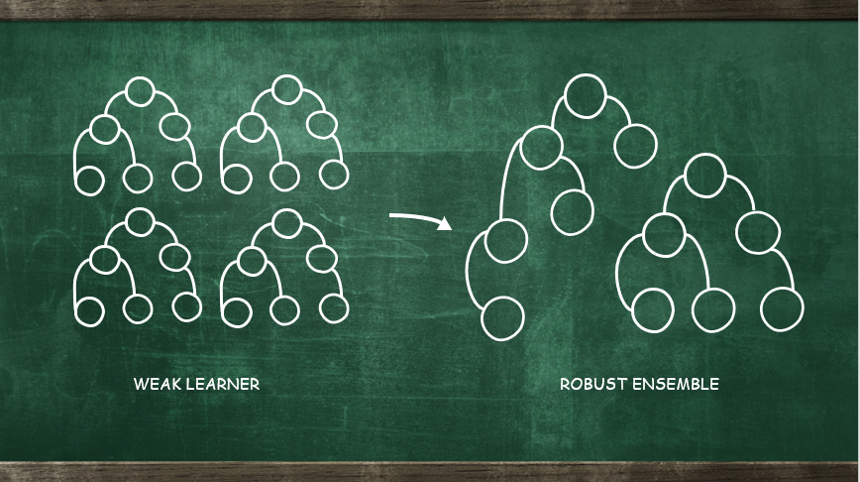
Algorithm
The technique utilised is based on the Radom Forest approach, which is associated with unsupervised learning
It builds decision trees on different samples and takes the majority voting for the process of classification K-Means divides things into clusters that share commonalities and are distinct to objects in another cluster

Slide 19
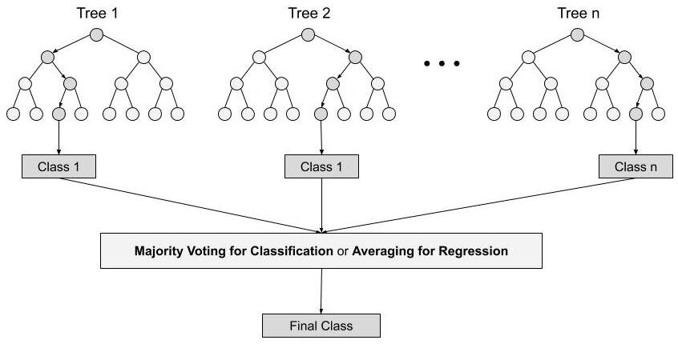
The clustering algorithm is categorized into three steps:
Here, ‘n’ random records are taken from dataset of ‘k’ records
Decision trees is constructed for each of the sample
Each of the decision trees generates an output
Thus, the final output will be based on majority voting (classification) or on the average (regression)

Slide 20


